Slide 1
Lab 1:- Data sensing and connection with PC

Slide 2
Why we need to print pc
Sensors data are depend on the connection as well as on noise.
Thus we check the value of sensors.

Slide 3
Before using the STM-kit For serial connection
First ensure that you have STM driver installed on your system.
You can download STM driver from.
http://www.st.com/en/development-tools/stsw-link009.html#getsoftware-scroll
For download the driver you need your e-mail.
After verifying the email Zip file will Download.
Extract Zip file and install dpinst_amd64.exe

Slide 4
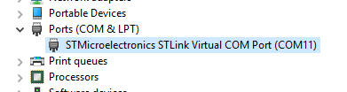
After Installing Driver
Step1 - Connect the STM32 kit.
Step2 - Go to device manager.
Step3 - Go to Ports (COM & LPT)
Step4 - Check which port number is used by STM kit.
Here COM11 is used by the kit.

Slide 5
Creating a print on PC program
Before creating print on PC program.
Ensure that you have a HyperTerminal installed on your computer.
HyperTerminal is a program that you can use to connect to other computers, devices and host computers.
HyperTerminal connections are made using a modem, null modem cable (VGA cable), USB cable, or an Ethernet connection.
Example of Hyper terminal software’s are, TeraTerm, CoolTerm etc.

Slide 6
Cool Term
In our programs we will be using CoolTerm.
You can download it from http://download.cnet.com/CoolTerm/3000-2383_4-10915882.html
After extracting the file you will gate CoolTerm.exe file.
This will be used for serial connection between PC and STM kit.

Slide 7
Codes to be include to c/cpp program
For using the CoolTerm or other HyperTerminal software. First we need to create connection in our program for serial communication.
Create connection using:
Serial pc(USBTX, USBRX);
pc is the function name.
Print data using the following print statement.
pc.printf(“-------------”);

Slide 8
Setting on CoolTerm
For receiving the data some setting also need on Hyper Terminal software's.
In our case (for CoolTerm) we are explaining the steps, setting steps can vary according to software's.
The default serial configuration in CoolTerm is 9600 bauds, 8-bit data.
If you have not set any bauds rate then no need to change on this. Else it can be set as per your program.

Slide 9
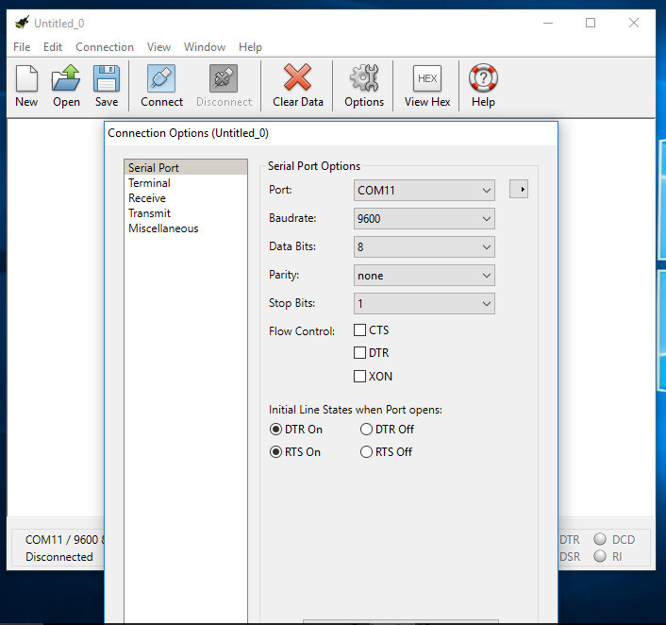
Connection b/w CoolTerm and STM kit.
Step1 - Open CoolTerm.exe file.
Step2 - Click on setting.
Step3 - Choose the port no that is used by STM kit then press ok.
Step4 - Press connect button.
Now STM kit is connected with CoolTerm.

Slide 10
Example
#include "mbed.h"
Serial pc(USBTX, USBRX);
int i=0;
int main(){
while(1) {
pc.printf("printing on pc %d \n ", i++);
wait(1.0); //wait for i second
}
}

Slide 11
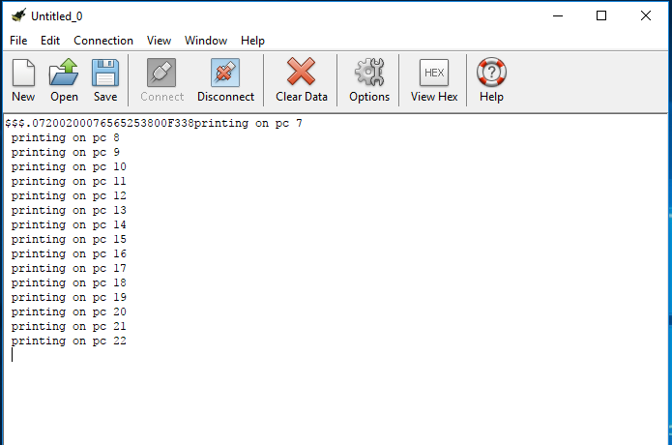
Output on CoolTerm

Slide 12
Input and Output

Slide 13
Sensors
An electronic device used to record data of environmental activity in the form of voltage readings.
A sensor can be any device that generates a signal or responds to a specific stimulus from the environment.
Ex:
Temperature Sensor
Motion Sensor
Touch Sensor
Light Sensor
Smoke Sensor, etc
Environment
Sensor

Slide 14
Analog Data
Analog data is not in discrete form of high voltage (true/1/Vcc) and low voltage (false/0/Gnd) but is a continuous range between 1 and 0 (ex. 0.6)
All the sensors/transducers that measure environmental data provide output in the form of Analog Signals

Slide 15
Reading analog input
#include “mbed.h”
Serial pc(USBTX, USBRX);
AnalogIn sensor(A0);
int main(){
float meas;
while(1) {
meas = sensor.read();
pc.printf(“Analog Value %f ”, meas);
wait(1);
}
}

Slide 16
Analog Value Read

Slide 17
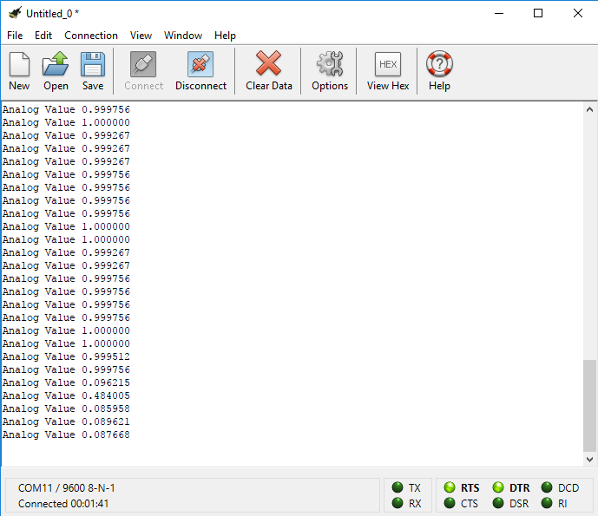
Output in CoolTerm (0.0 to 1.0)

Slide 18
Digital Port input
#include “mbed.h”
Serial pc(USBTX, USBRX);
DigitalIn In1(LED1);
int main(){
float meas;
while(1) {
meas = In1.read();
pc.printf(“Digital Input %f ”, meas);
}
}

Slide 19
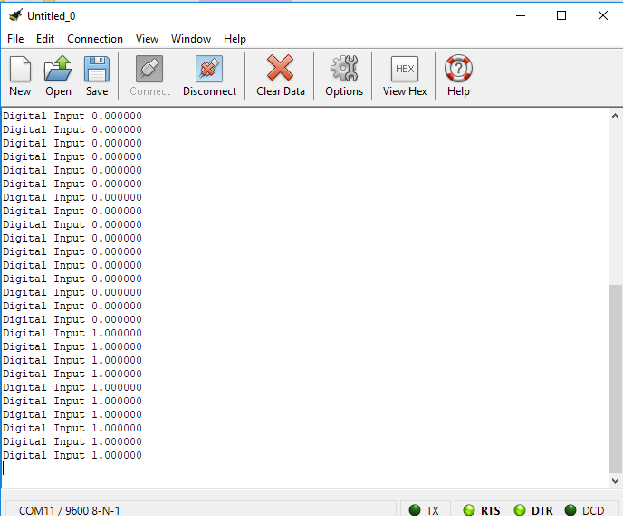
Output in CoolTerm (0 or 1)

Slide 20
Digital Port output
#include "mbed.h"
Serial pc(USBTX, USBRX);
DigitalOut Out(D2);
int main(){
float meas;
while(1) {
Out=1;
wait(.2); // Wait for 1 second
}
}

Slide 21
Output

Slide 22
Thank you

